Slide 1
Part 2 machine learning with MLP
Applying MLP with clustring to give a higher accuracy
Deep learning neural networks learn how to map inputs to outputs
use of small weights in the model and the use of error between predictions and expected values
Data preparation :
Standrizatin
Normalization

Slide 2
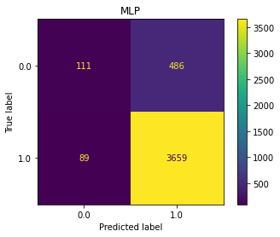
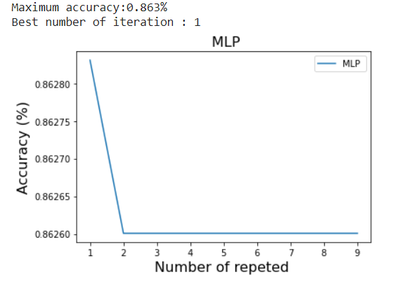
Accuracy
Apply Maltilayer perciptrun on data we get the accuracy
The foult of the model in the class with less data
Apply model with 10 tyme to

Slide 3
Data preparation
Data need more preparation because it skewed not balanced
Select feature that affect using feature selection

Slide 4
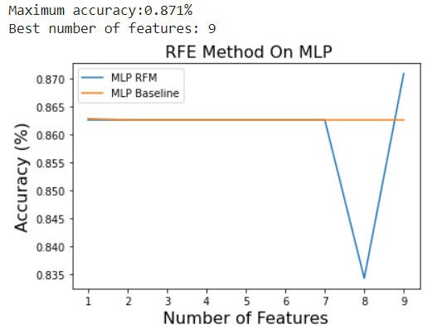
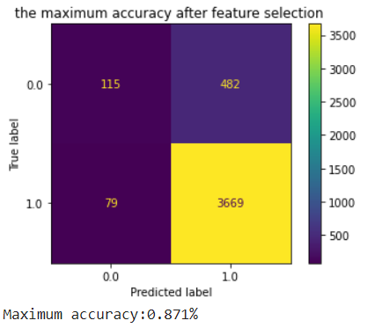
Feature selection (Sequential Feature Selector)
use wrapper methods we select (Sequential Feature Selector)
In wrapper methods, the feature selection process is based on a specific machine learning algorithm that we are trying to fit
It follows a greedy search approach
Max accuracy =87.1%

Slide 5
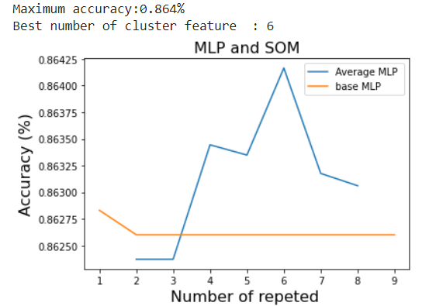
SOM clustering
Apply SOM cluster from (2 ,8 )cluster
add prediction to training and test data as new feature
Train and test MLP on new data
Best accuracy =86.4%

Slide 6
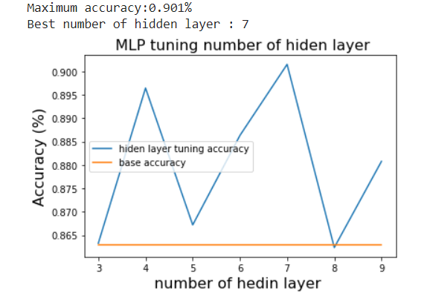
Tuning model (number of hidden layer)
Change hidden layer start from 3 to 10.
I initialize it by 20 neurons in each layer.
The best number of layer = 7.

Slide 7
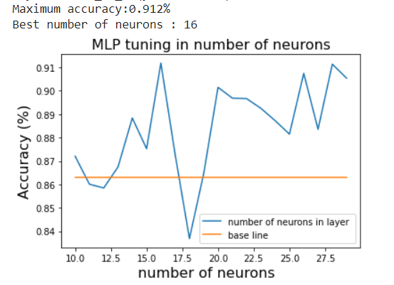
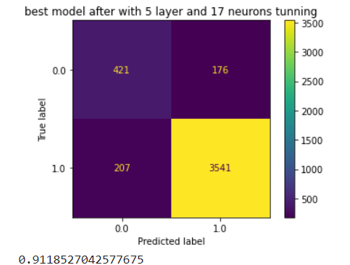
Tuning model (number of neurons )
Get the best number of neurons in each layer
We apply the tuning from (10 ,30) neurons
The best numbers is 16 neurons
With accuracy 0.912

Slide 8
Results
Defualt | Wrapper method | SOM | Tuning hidden layer | Tune number of neurons
0.863 | 0.871 | 0.866 | 0.901 | 0.912

Slide 9
Conclusion :
The data in real life is not clean we can’t take any information without making preprocessing
Preprocessing operation different by different of data, so cleaning it is important
Before training the model we need to check data is balanced or not because that effect model prediction and give a good accuracy, perception, and recall
Every model can give good accuracy is dependent on the shape of the data
This Sequential Feature Selector is a greedy algorithm that takes so much time in big data
MLP cluster needs more tuning to reach the best number of neurons and number of hidden layers and this is cost and time effort
MLP gives a good result with huge data rather than small

